Slide 1
Color Theory and Typography
By Hout Tang
Comp4631s2022

Slide 2
Content
Color Theory
Typography

Slide 3
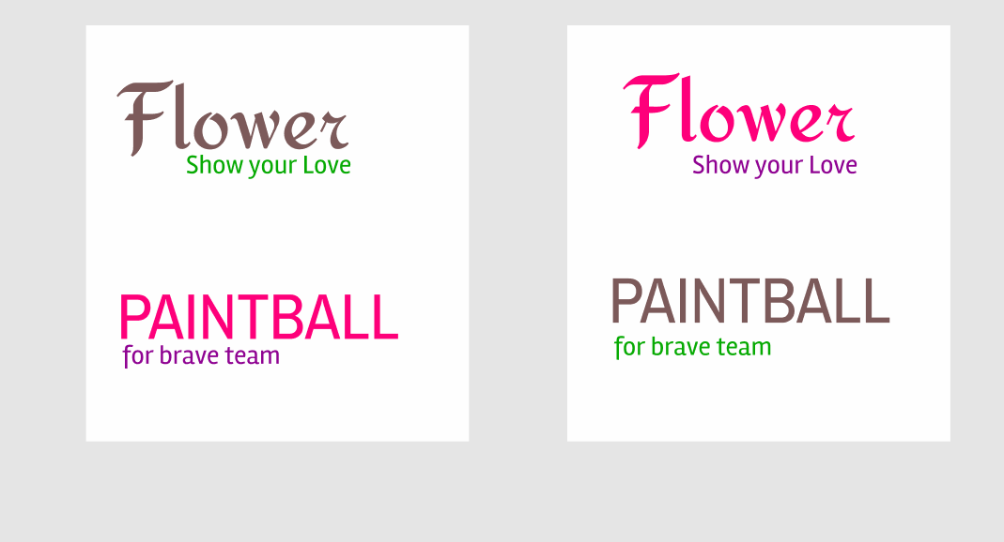
Color Theory
Color Theory is the act and science to create the right palette for your mobile application.

Slide 4
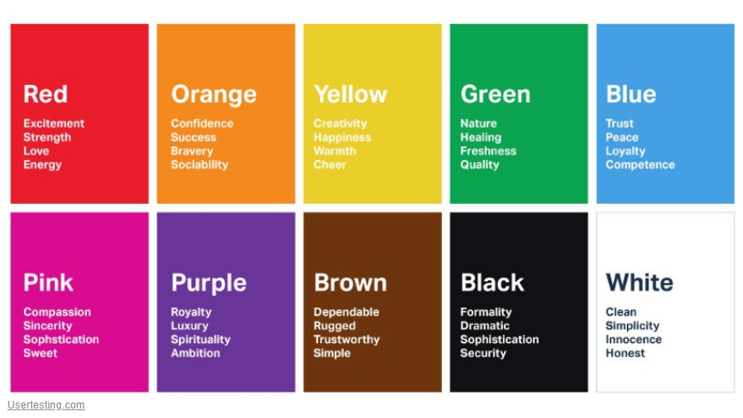
Color Theory

Slide 5
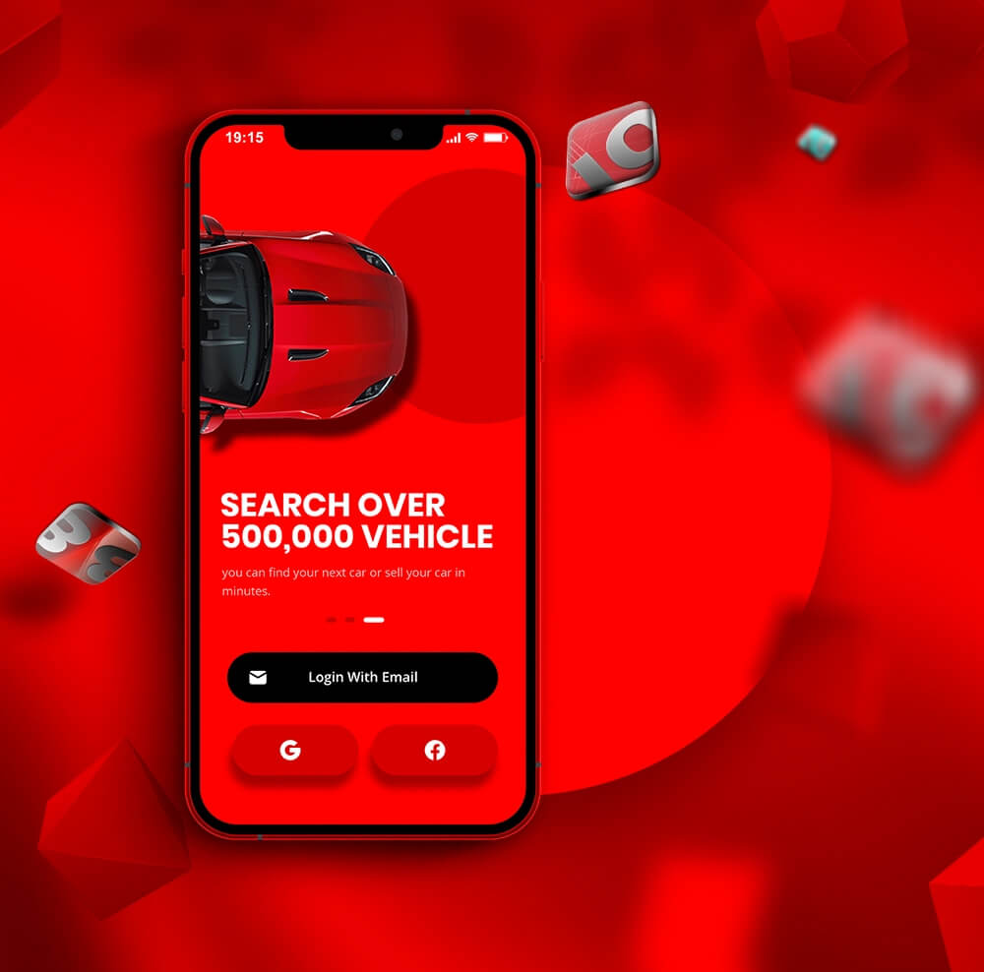
Color Theory
Energy
Excitement

Slide 6

Color Theory
Trust
Loyal

Slide 7
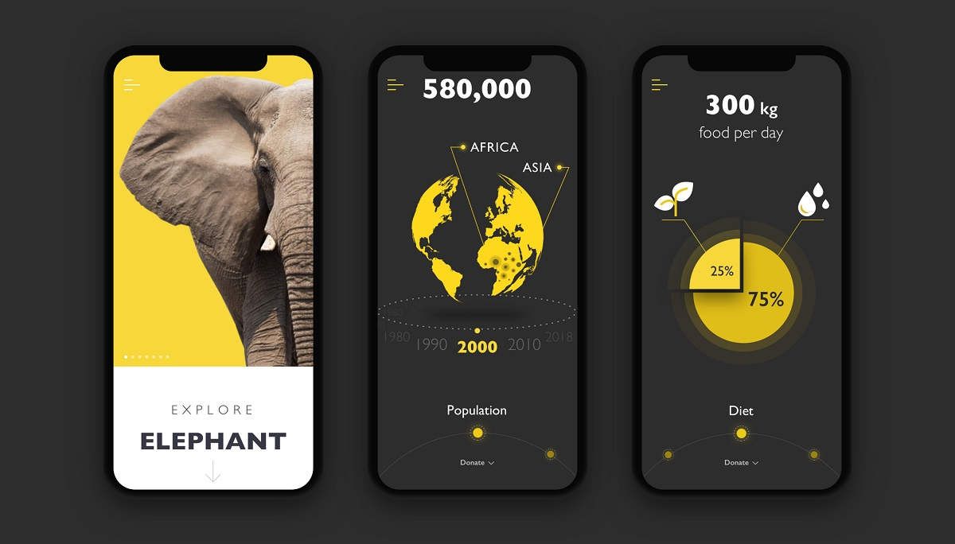
Color Theory
Creativity
Attract

Slide 8

Color Theory
Natural
Quality

Slide 9
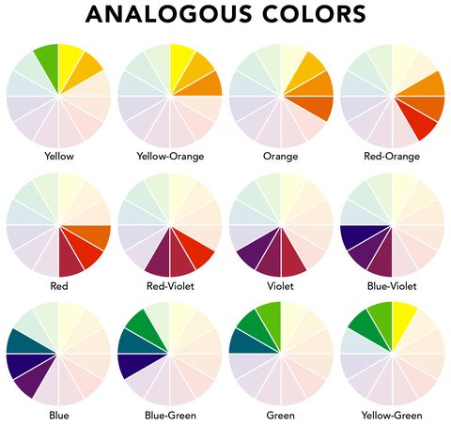
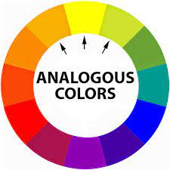
Color Theory- (Color Combination)

Slide 10


Color Theory- (Color Combination)
Analogous Color

Slide 11
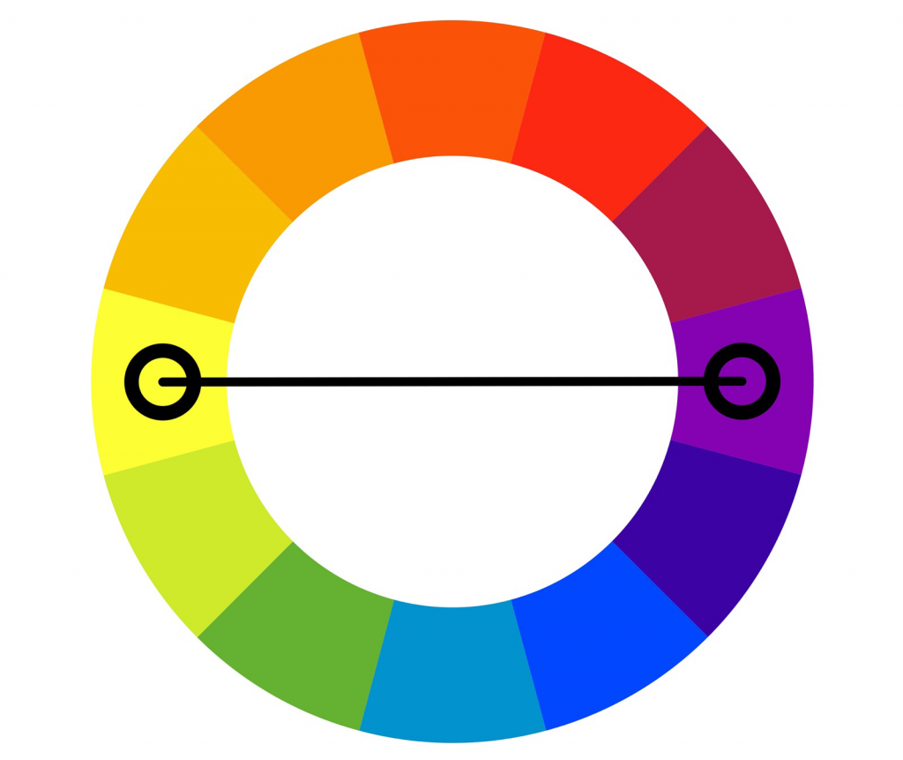

Color Theory- (Color Combination)
Complementary Color

Slide 12
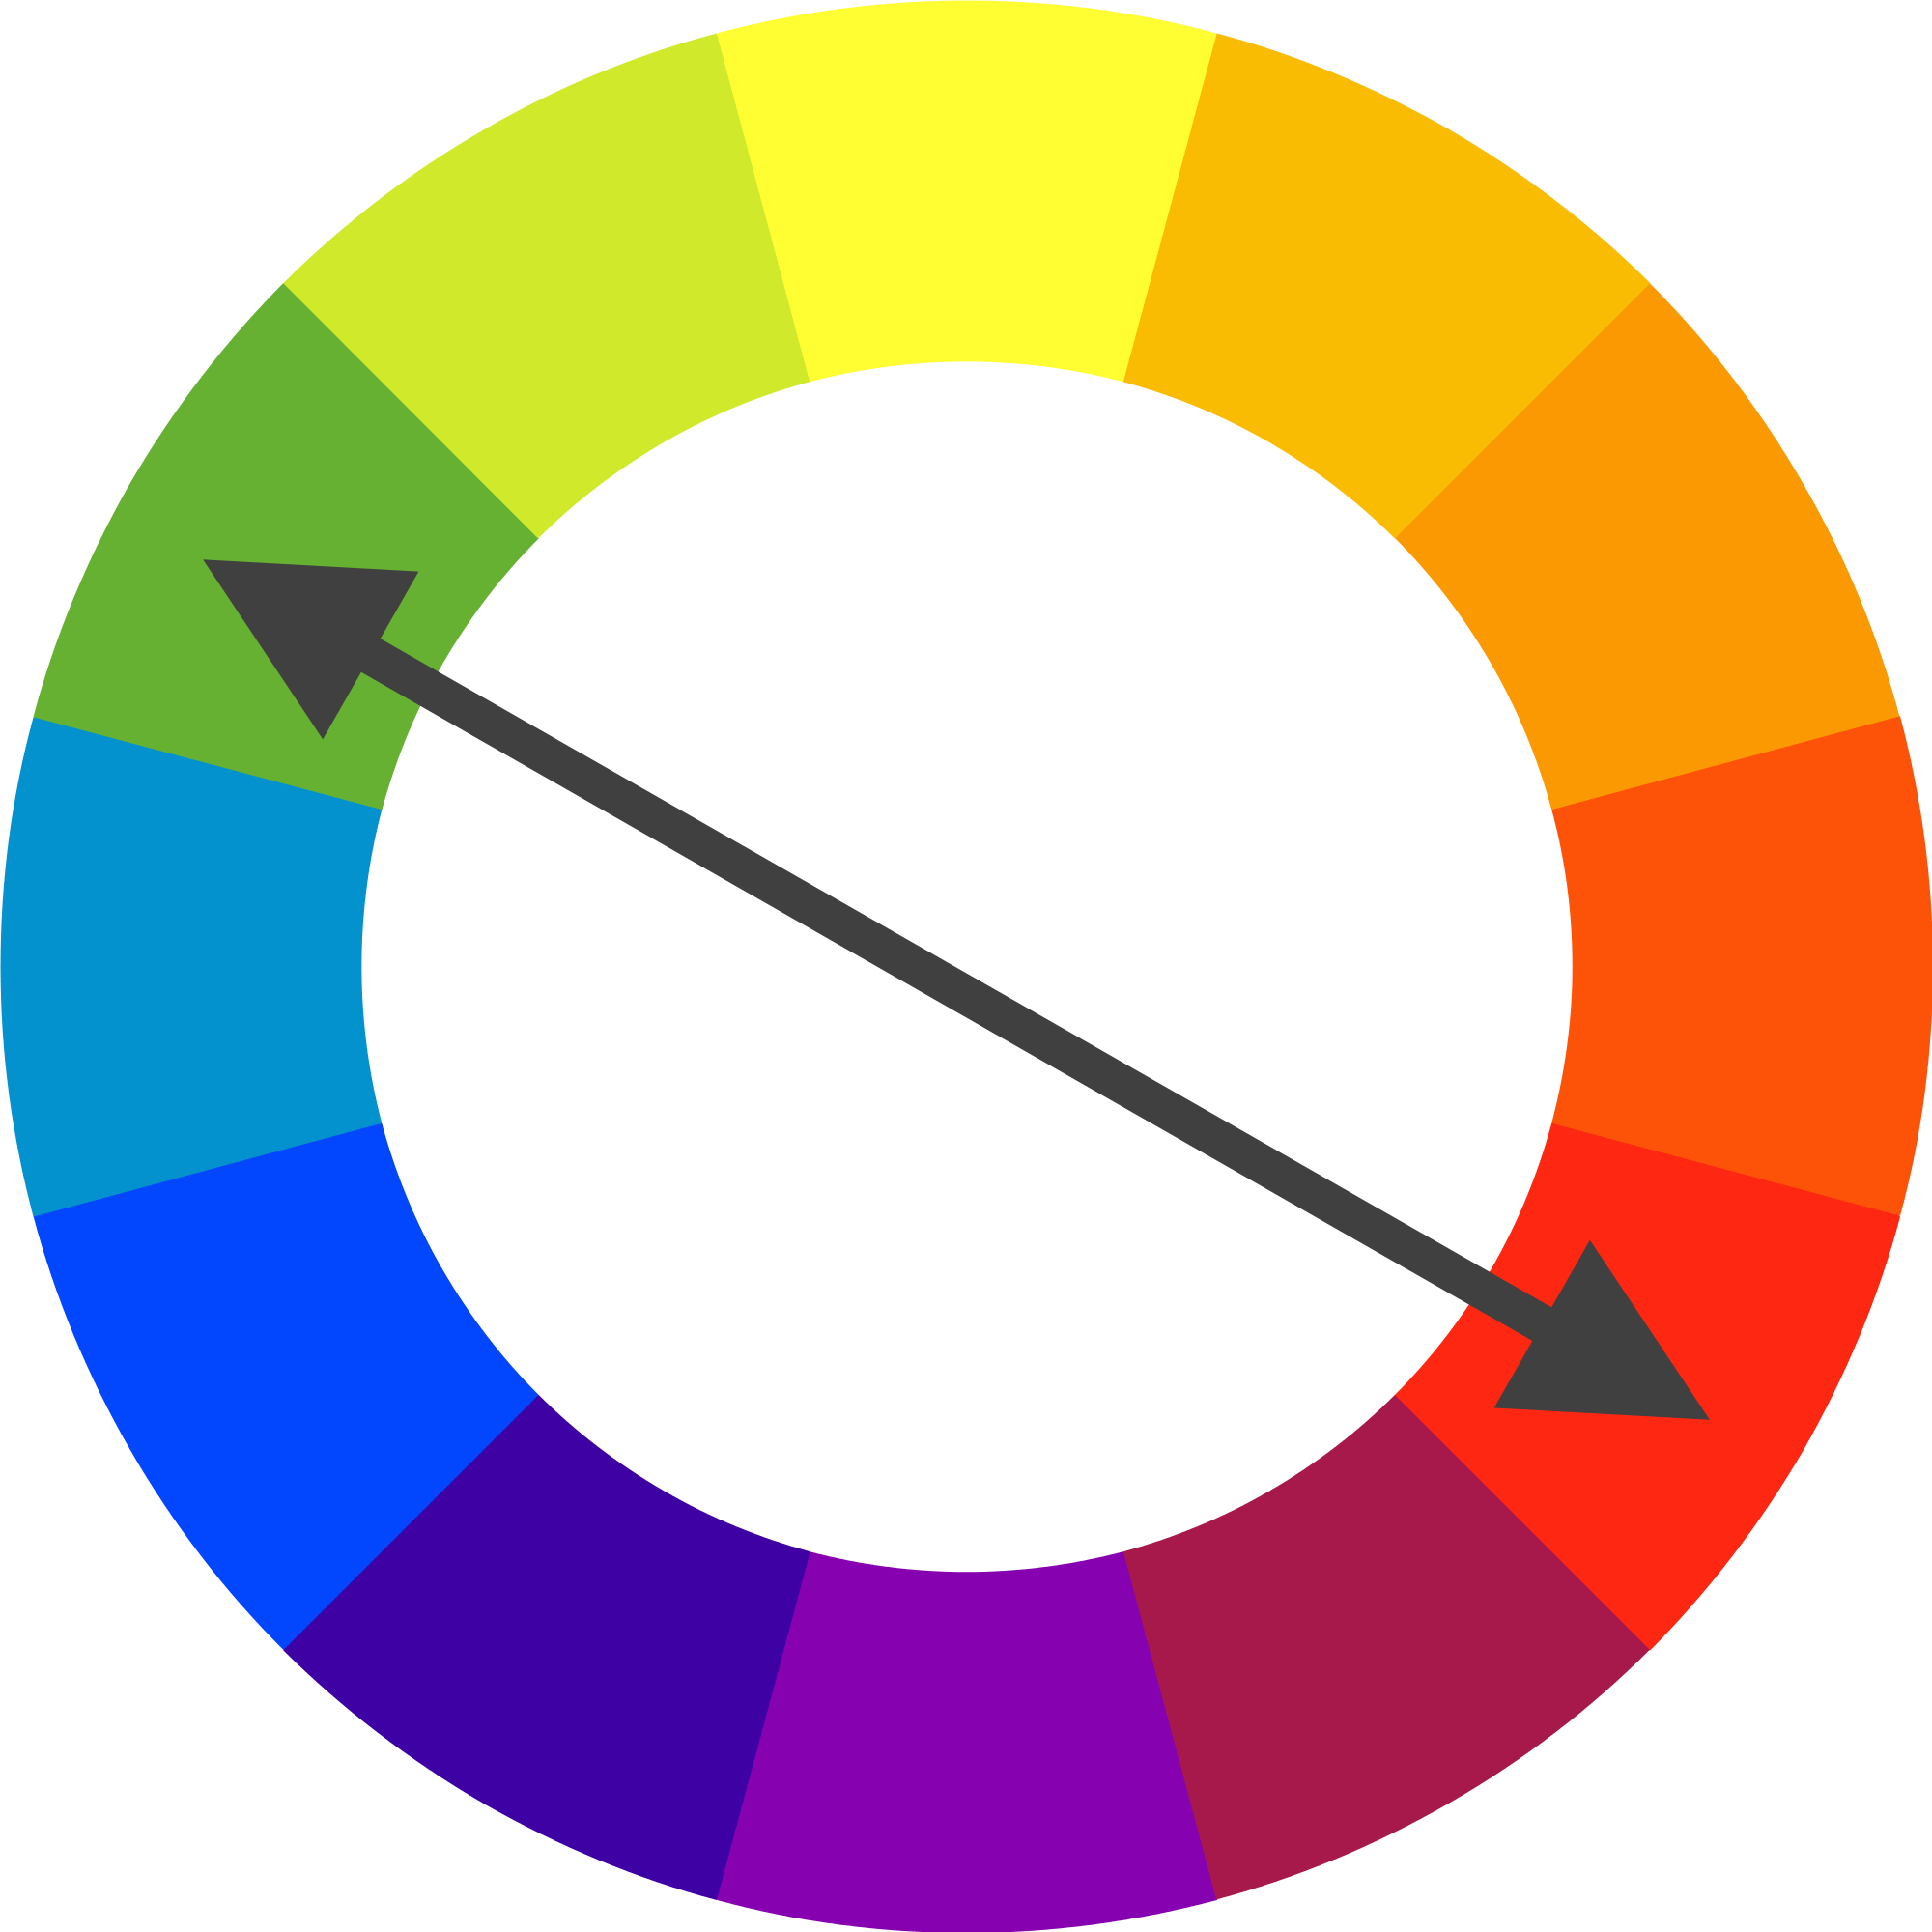

Color Theory- (Color Combination)

Slide 13
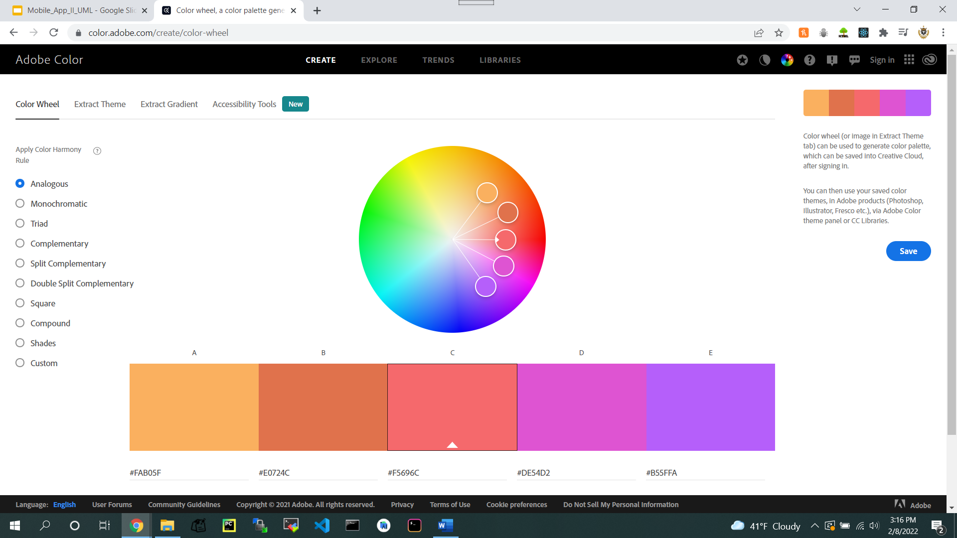
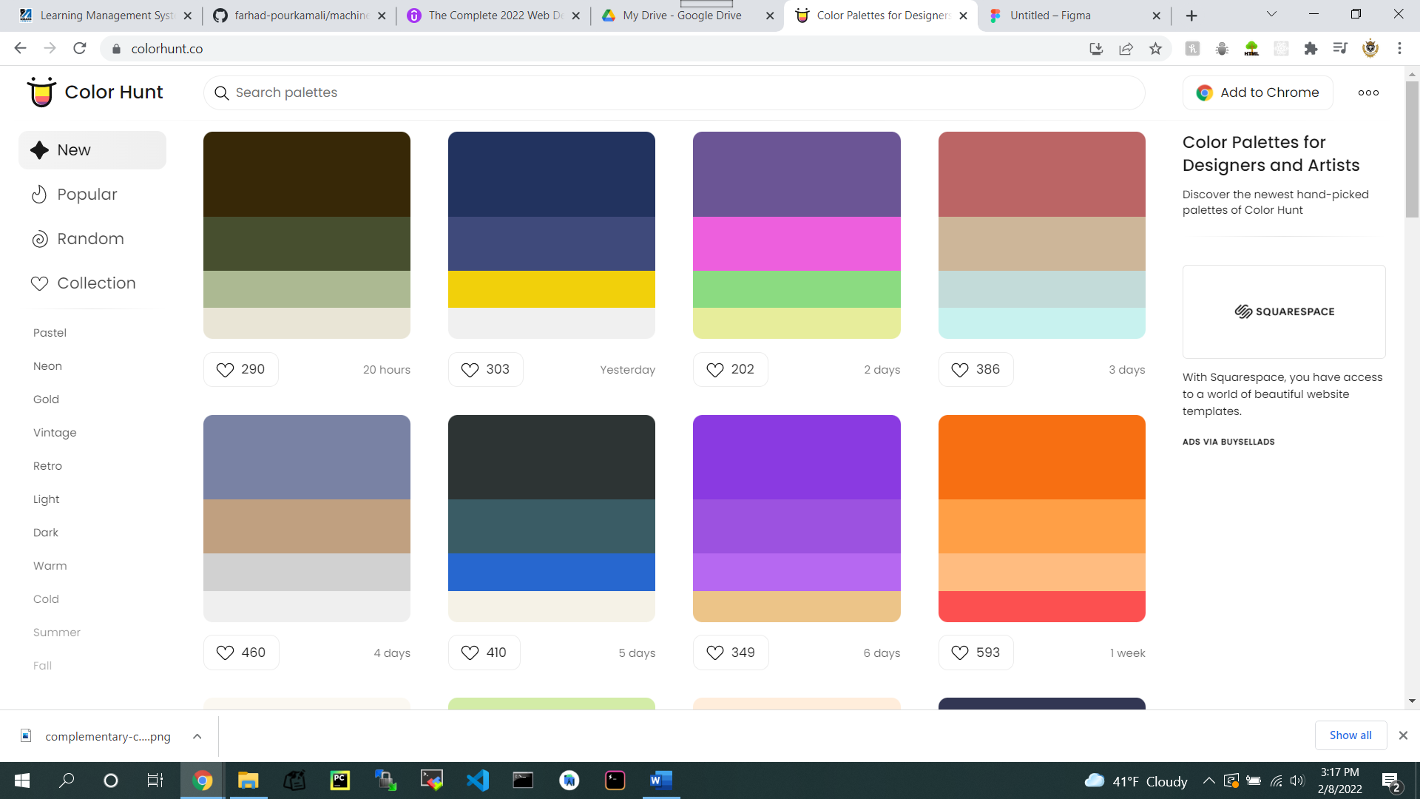
Color Theory- (Color Combination)

Slide 14
Color Theory
Consistent Colors Scheme
Design Stand Out
Great User Exp.

Slide 15
2. Typography
Serif
San serif

Slide 16
2. Typography-Serif
Serif
Traditional
Established
Trustworthy

Slide 17
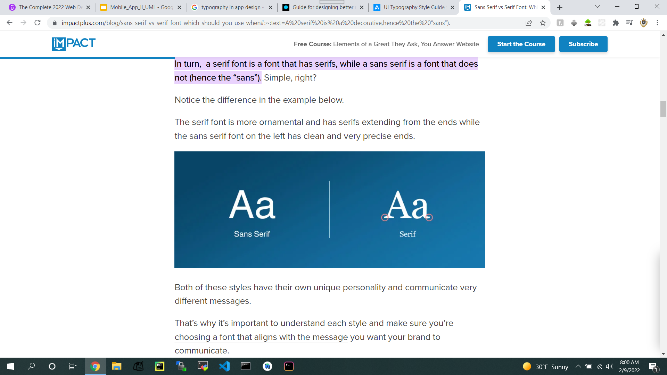
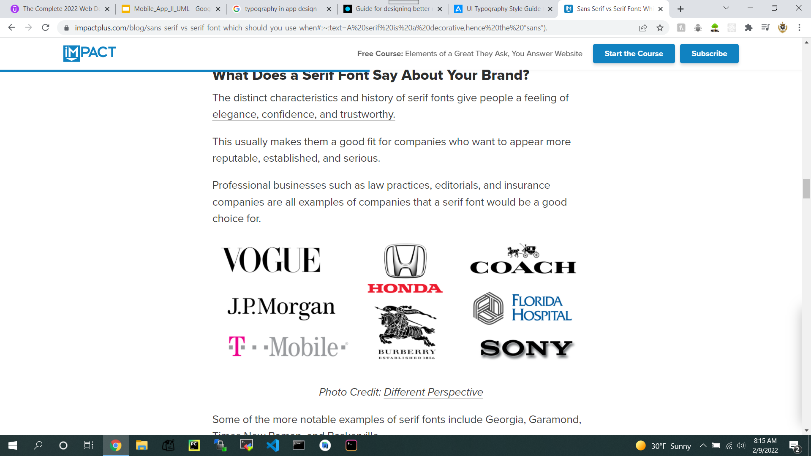
2. Typography-Serif

Slide 18
2. Typography-San Serif
San Serif
Modern
Approachable
Clean

Slide 19

2. Typography-San Serif

Slide 20
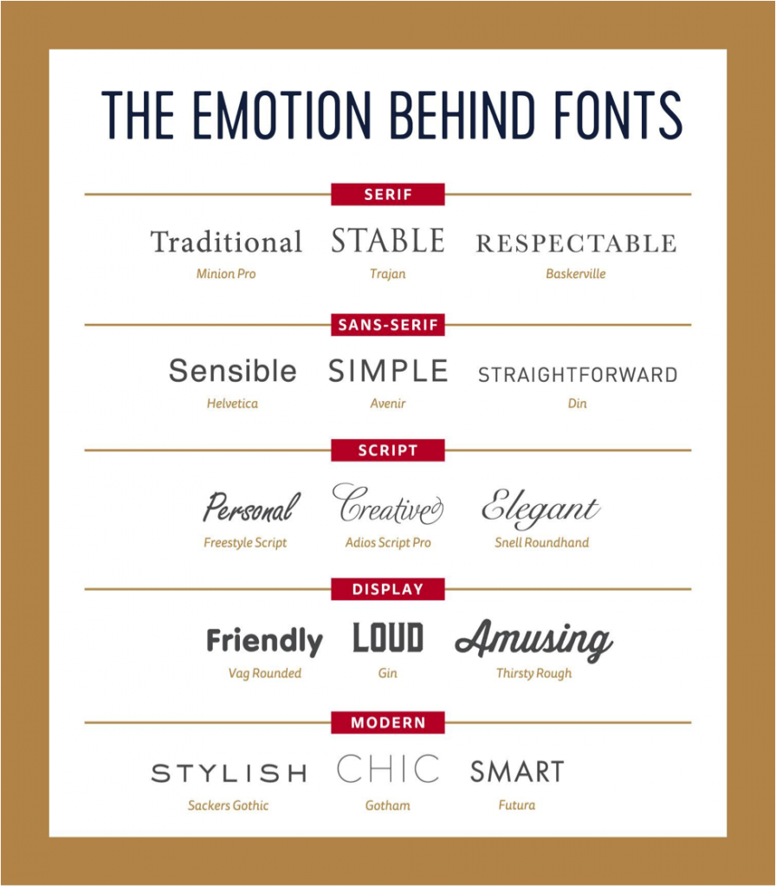

Slide 21
2. Typography
How to choose Fonts based on your App ?

Slide 22

2. Typography
Don’t Overload Your Brand With Too Many Fonts

Slide 23
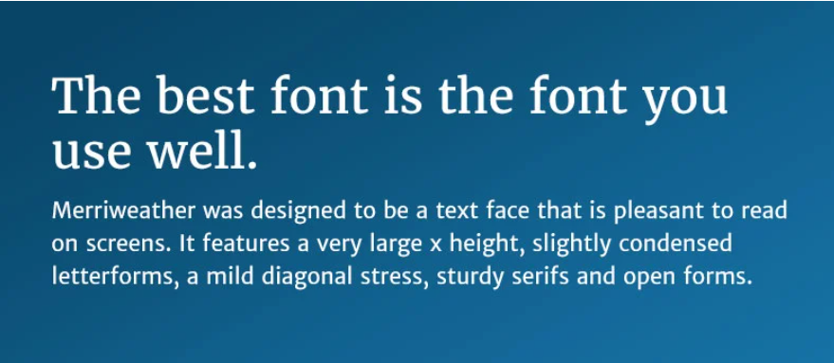
2. Typography
Choose Fonts That Have the Right Amount of Contrast.

Slide 24
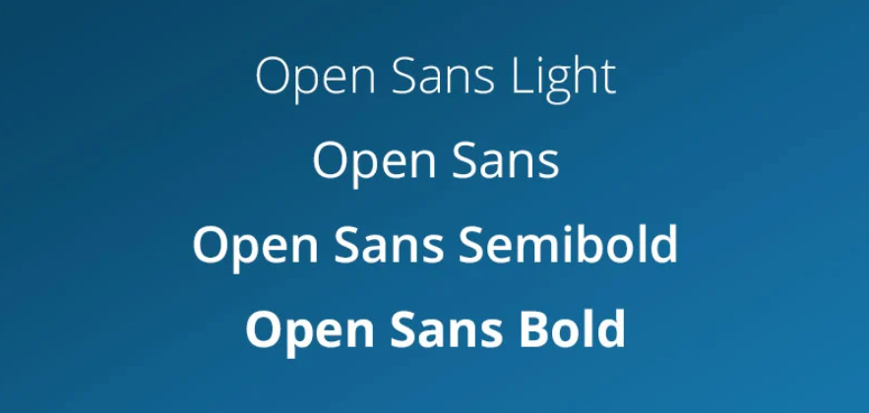
2. Typography
Look for a Font With Multiple Weights and Styles

Slide 25
Thank You !

